Slide 1
Final Project_NY_Airbnb_Analysis
File created on: 8/16/23 11:04:38 PM PDT

Slide 2
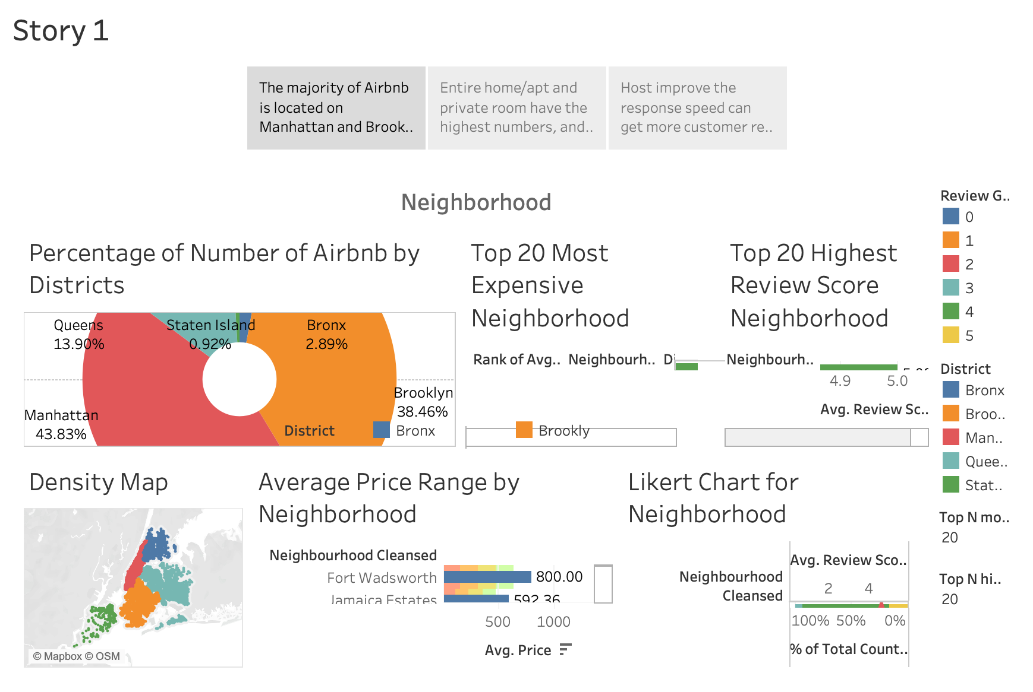

Slide 3
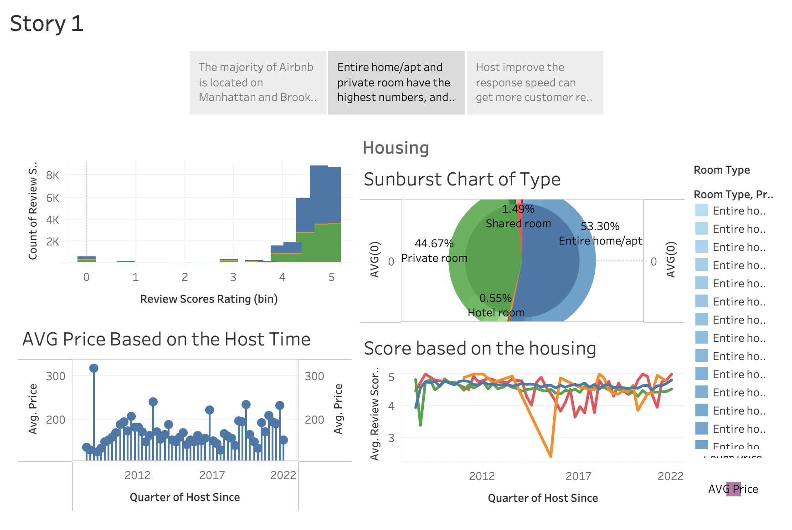

Slide 4
